Slide 1
Molecular Biology Biol 480
Lecture 18 March 1st , 2019

Slide 2
Announcements/Assignments
Handed out presentation assignment last week and asked you to read. We will discuss today.
No lecture March 8th. This is the ND Academy of Science meeting in Grand Forks.
Will have exam 2 graded and left outside my office—Thursday by 3.

Slide 3
Where were we?
How proteins bind to DNA. So far we have discussed quite a few DNA binding proteins.
We have named several eukaryotic transcription factors…
Eukaryotic DNA-binding motifs (common protein shape patters in different proteins that allow binding to DNA).

Slide 4
We will study more of these DNA binding proteins soon. They have cool names that describe a shape that allows them to bind DNA.
Helix-loop-helix
Helix-turn-helix
Leucine zipper
Zinc finger

Slide 5
Transcription Factor MyoD is a H-L-H protein which binds genes encoding proteins needed for muscle development.

Slide 7
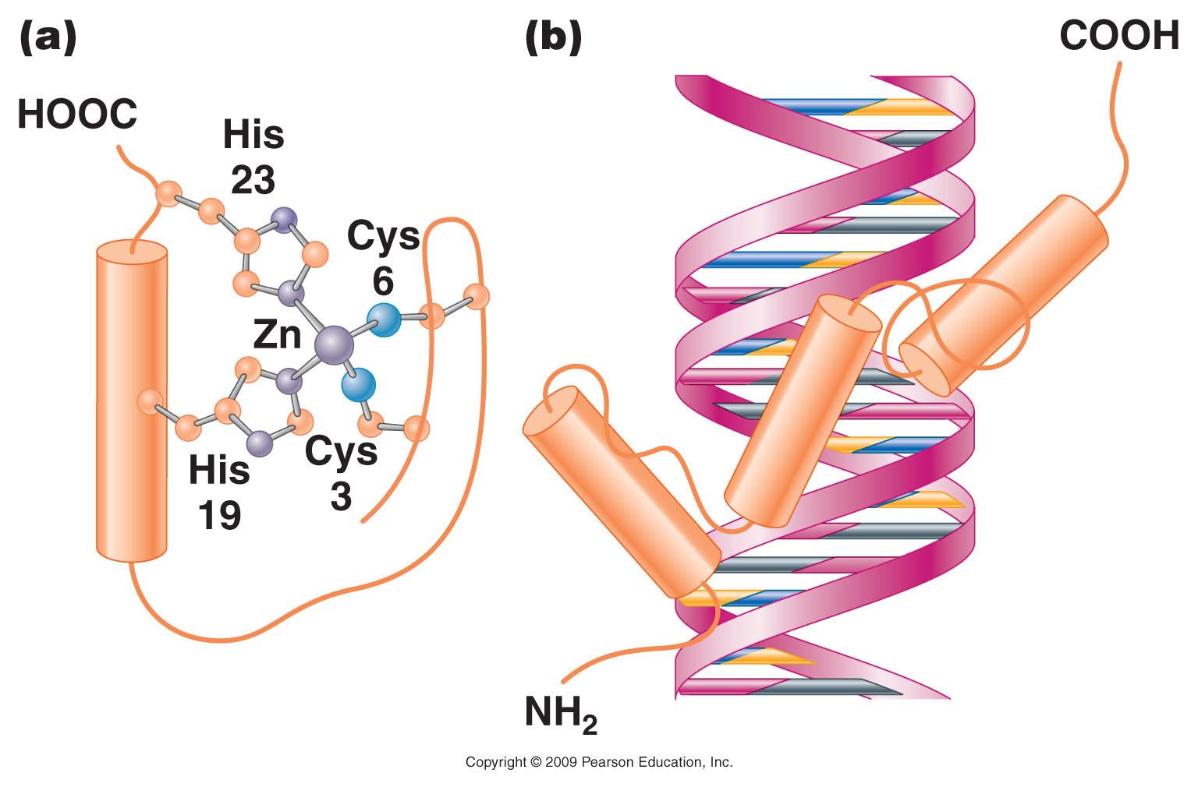
Figure 18.12
Notes:
Figure 18-12 (a) A zinc finger in which cysteine and histidine residues bind to a Zn²⁺ atom. (b) This loops the amino acid chain out into a fingerlike configuration.

Slide 8
The estrogen receptor protein binds DNA with a Zn finger motif

Slide 9
Leucine zipper—transcription Factors usually consist of 2 identical proteins (dimer) that interact with each other and DNA at the same time.

Slide 10
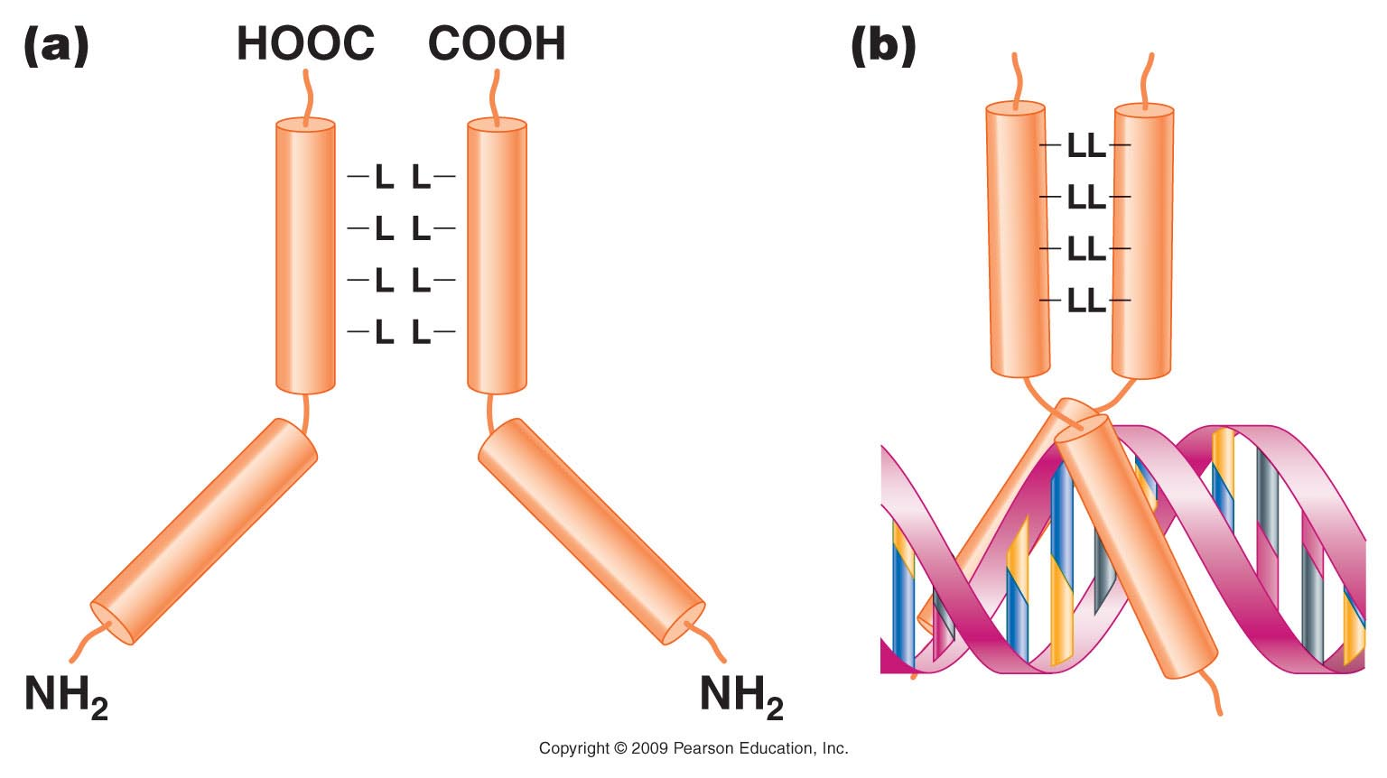
Figure 18.13
Notes:
Figure 18-13 (a) A leucine zipper is the result of dimers from leucine residue at every other turn of the -helix in facing stretches of two polypeptide chains. (b) When the -helical regions form a leucine zipper, the regions beyond the zipper form a Y-shaped region that grips the DNA in a scissorlike configuration.

Slide 11
AP-1 is actually 2 different proteins that bind each other through interactions between lots of leucines in both proteins. A second part of each protein interacts with DNA.

Slide 12
Where were we…
Eukaryotic mRNA (transcript) modifications

Slide 13
RNA processing
5’ modification---addition of a modified guanosine tri-phosphate.
3’ modification---cleavage of 3’ end and addition of a poly A sequence.
Internal modification---removal of RNA known as introns and splicing together adjacent RNA known as exons. (RNA splicing)

Slide 14
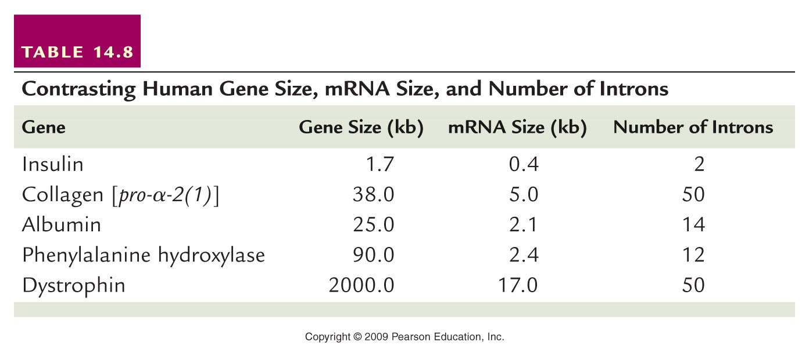
Table 14.8
Notes:
Table 14-8 Contrasting Human Gene Size, mRNA Size, and the Number of Introns

Slide 15
Most genes of eukaryotes have introns. The average number is ~8 introns/gene.
Some exceptions…Histone genes have no introns!
…We will return to splicing shortly…

Slide 16
Additional resources at NCBI (NCBI bookshelf)
http://www.ncbi.nlm.nih.gov/books/NBK9846/
READ!

Slide 17
Back to RNA splicing. Since introns are unique to eukaryotic genes and since much of the early work in transcription and translation was done in prokaryotes, the existence of introns was not even discovered until the 1970s

Slide 18
In 1977, three people, Susan Berget, Phil Sharp, and Richard Roberts noticed that a virus, in a family called adenovirus, made longer RNA molecules that were eventually shortened.
Using hybridization techniques and electron microscopy, they compared the longer and shorter RNAs and the RNAs to the DNA that encoded them.

Slide 19
They noted that specific portions of the DNA sequence were missing in the RNA.
Sharp referred to this as “split genes”. The genes were shown to be interrupted with non-amino acid coding, intervening sequences.
These were later termed introns.

Slide 20
(from the cytoplasm)

Slide 21
Splicing mechanism
Although there are different types of introns based on the exact mechanism by which they are removed, we will focus first on introns that require a large protein/RNA complex for removal.
The complex is called the spliceosome.

Slide 22
Not surprising---the removal of introns also relies on conserved nucleotide sequence.
Most mRNA introns have at their 5’ end, GU (splice donor sequence), and at their 3’end, AG (splice acceptor sequence)
Somewhere in the intron sequence, closer to the 3’ end is a conserved A which will be utilized in the removal. The A nucleotide is known as the branch point.
Other parts of introns are less conserved, but may have some consensus.

Slide 24
In a sense, this is a loose consensus. DNA sequence can be analyzed to find introns in larger gene sequence.

Slide 25
Components of the spliceosome
Small RNAs, found only in the nucleus, play an essential role in splicing. These “small nuclear RNAs—snRNAs, interact with small nuclear proteins to form small nuclear ribonucleoprotiens (snRNPs or snurps).
The snRNAs are rich in U and have been named “U1, U2, U3, U4, U5, and U6”

Slide 26
Different “U” snRNAs bind to different parts of the intron (by complementary base-pairing) and facilitate interactions of snRNAs and protein components of the spliceosome. The branchpoint A becomes joined to the donor site, forming a loop.
Since the loop forms with nucleotides in the middle of the intron the 3’ end of the intron extends like a tail.

Slide 27
Eventually there is a cleavage of the 3’ acceptor site which simultaneously releases the loop of intron and joins the nucleotides on either side of the intron.
The released intron resembles a lariat.
STUDY this in detail!

Slide 28
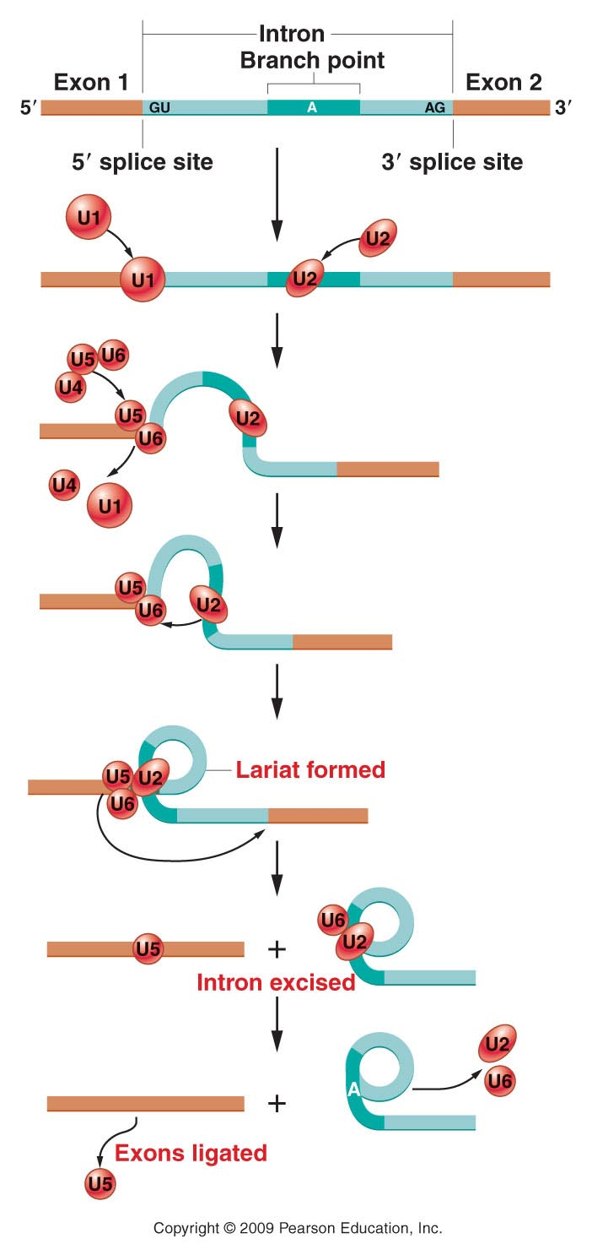
Figure 13.14
Notes:
Figure 14-14 A model of the splicing mechanism involved with the removal of an intron from a pre-mRNA. Excision is dependent on various snRNAs (U1, U2, U6) that combine with proteins to form snRNPs (snurps), which function as part of a large structure referred to as the spliceosome. The lariat structure in the intermediate stage is characteristic of this mechanism.

Slide 29
Watch animation.
http://www.dnalc.org/view/16938-3D-Animation-of-RNA-Splicing.html

Slide 30
Interestingly, some introns, such as those found in rRNA in eukaryotes undergo splicing without any protein enzymes. All the enzymatic activity comes from the RNA (intron) itself.
As such, these introns, known as Group 1 introns, undergo self-splicing.

Slide 31
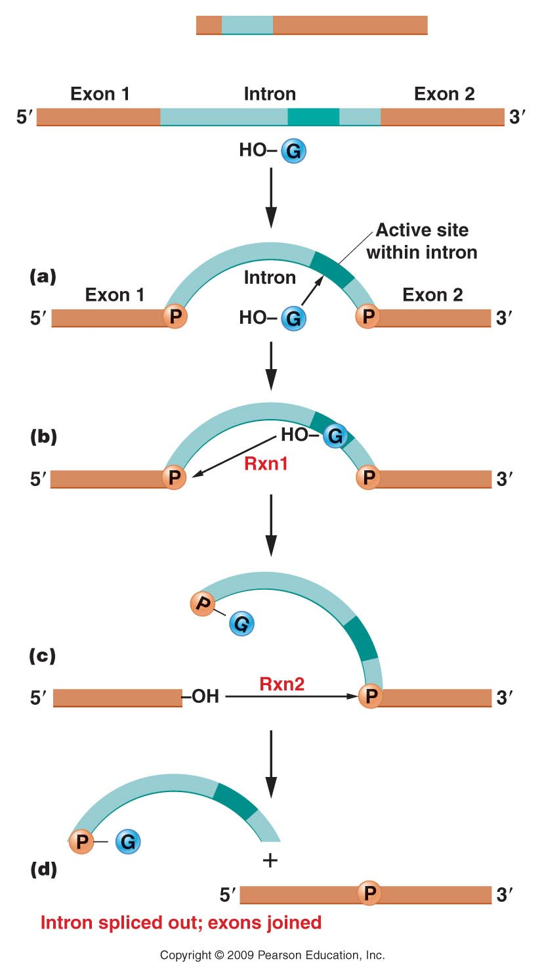
Figure 14.13
Notes:
Figure 14-13 Splicing mechanism involved with group I introns removed from the primary transcript leading to rRNA. The process is one of self-excision involving two transesterification reactions.

Slide 32
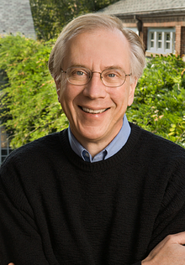
Thomas Cech made this discovery using a protozoan called Tetrahymena. Self-splicing rRNAs have been seen in other protozoans as well.
He was awarded a Nobel prize
in 1989.

Slide 33
Up until that point in time, no one had ever attributed catalytic/enzymatic activity to RNA.
Dogma said, “all enzymes are proteins”.
At this point, a new type of RNA-only enzyme was discovered. Catalytic RNA became known as ribozymes.
Now we know lots of examples of enzymatic activity of RNA.

Slide 34
A similar process goes on in the mRNA and tRNA transcribed from DNA in mitochondria and chloroplasts!
Amazing! The discover of catalytic RNA supports the notion that RNA was likely the first type of biomolecule in living cells. Why?
Based on shapes that RNA can assume, is this reasonable?

Slide 35
Recognizing RNA as a more versatile molecule, also helps us understand that the non-protein coding DNA in our cells is likely not really “junk DNA”.
Explain!

Slide 36
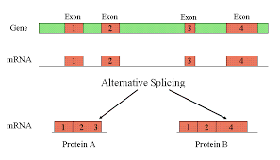
Alternative splicing
Some mRNAs can be spliced in more than one way. Different exons are spliced together, creating different coding sequences for a protein.

Slide 37
Making more than one protein from a gene

Slide 38
http://www.youtube.com/watch?v=p2uC5j0hK0A
Alternative splicing, again, partially explains how, what appears to be a rather low number of protein coding genes in the human genome, may encode many more proteins than we first estimated. Explain!

Slide 39
How important is splicing?
Mistakes in splicing have been linked to diseases. Usually we look for mutations only in exons---why?
How might a nucleotide change in an intron cause a protein to be altered?

Slide 40
Spinal Muscular Dystrophy
http://www.dnalc.org/view/16941-2D-Animation-of-Alternative-RNA-Splicing.html

Slide 41
One final post-transcriptional alteration
RNA editing
In the late 1980s, it was discovered that a few eukaryotic RNAs had slightly different nucleotide sequence than the DNA from which they were derived.
OH NO! Another exception to DOGMA!

Slide 42
The changes seemed to be both:
Substitutions---changing one nucleotide to another.
AND
--Insertions or deletions of RNA nucleotides

Slide 43
RNA editing was first studied in a protozoan, parasite, Trypanosoma, which causes a disease called African Sleeping Sickness.
Special RNAs called a “guide RNA”/gRNAs seems to direct the editing by binding to complementary RNA and directing editing enzymes to insert short stretches of RNA.

Slide 44
We will discuss and example of RNA editing in a mammalian gene/RNA for Apolipoprotein.

